Slide 1
The Covid Crises

Slide 12
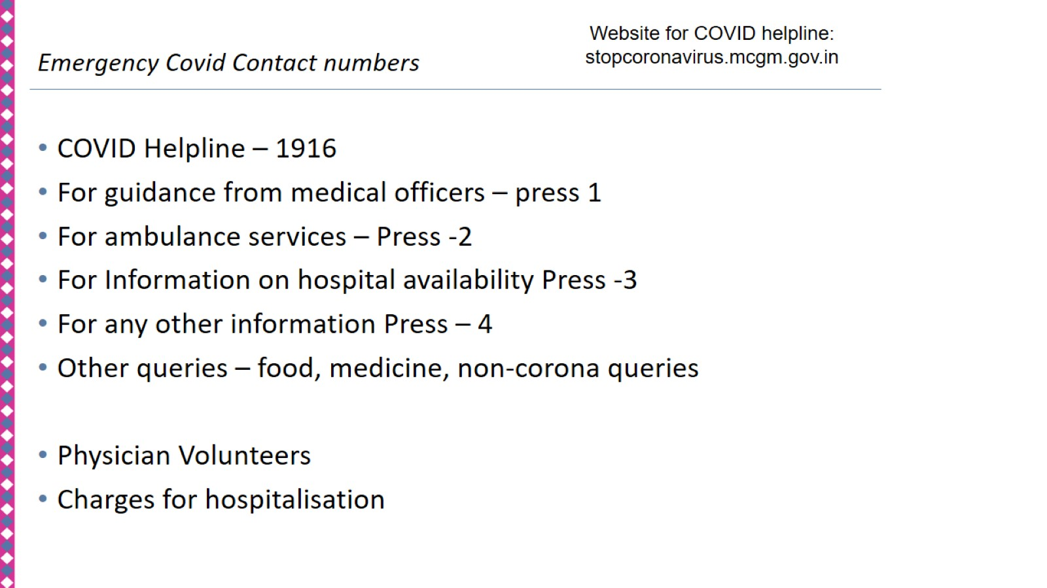

Slide 16
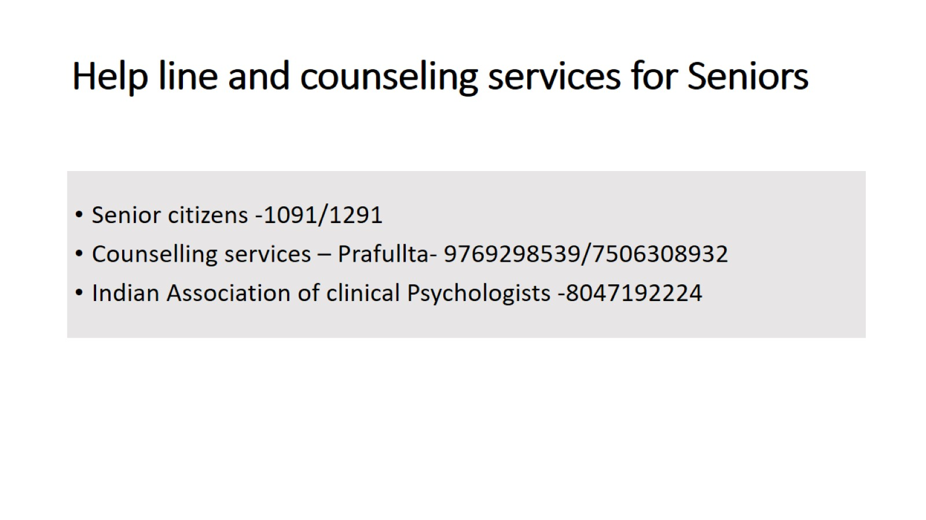
Help line and counseling services for Seniors

Slide 18
Who needs Palliative care ?

Slide 19
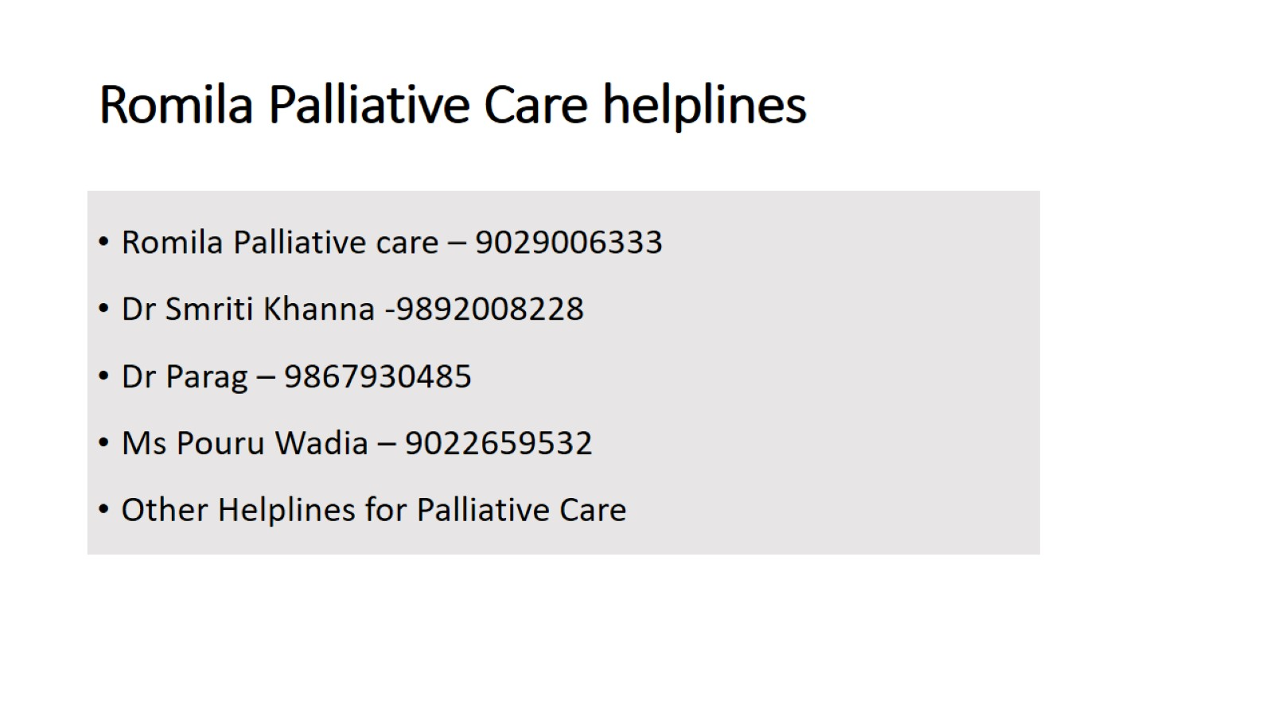
Romila Palliative Care helplines

Slide 22
Violence Against Women & Children: Fertile ground provided by Social Isolation due to COVID19 Pandemic Lockdown

Slide 23
Domestic violence, Sexual Violence, Child Sexual Abuse : SHADOW PANDEMIC

Slide 26
Helplines for People in Difficult Circumstances

Slide 27
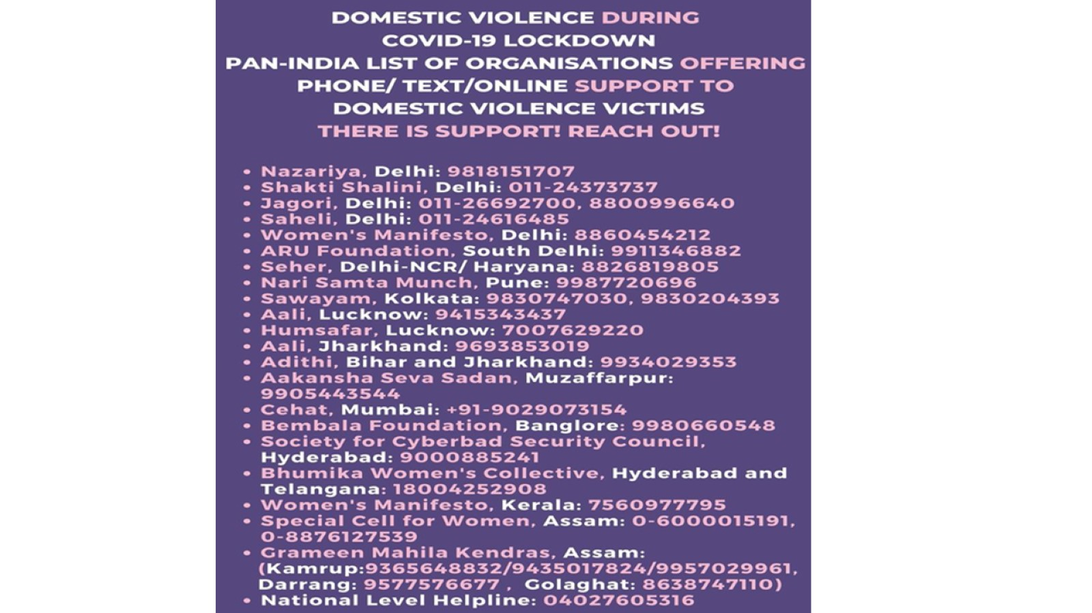

Slide 28
Do not get discouraged by evasive responses from shelter homes. Look out for alternate sources:

Slide 30
Legal Awareness The IPC Section Nature of Offence 304 B Dowry death/ murder 354 Criminal assault of women to outrage women’s modesty 366 Kidnap, abduction and marriage of a women by force. 366 A Procurement of a minor girl 366 B Import of girl from a foreign country 376 Rape 376 A Intercourse by a man with his wife during judicial separation 376 B Intercourse by a public servant with woman in his custody 376 C Intercourse by superintendent of jail, remand home with women in his custody. 376 D Intercourse by any member of the management or staff of a hospital with any woman in that hospital 498 A Husband or in-laws subjecting a woman to cruelty 509 Word, gesture or act intended to insult the modesty of a woman

Slide 31
Thank you

